Slide 1
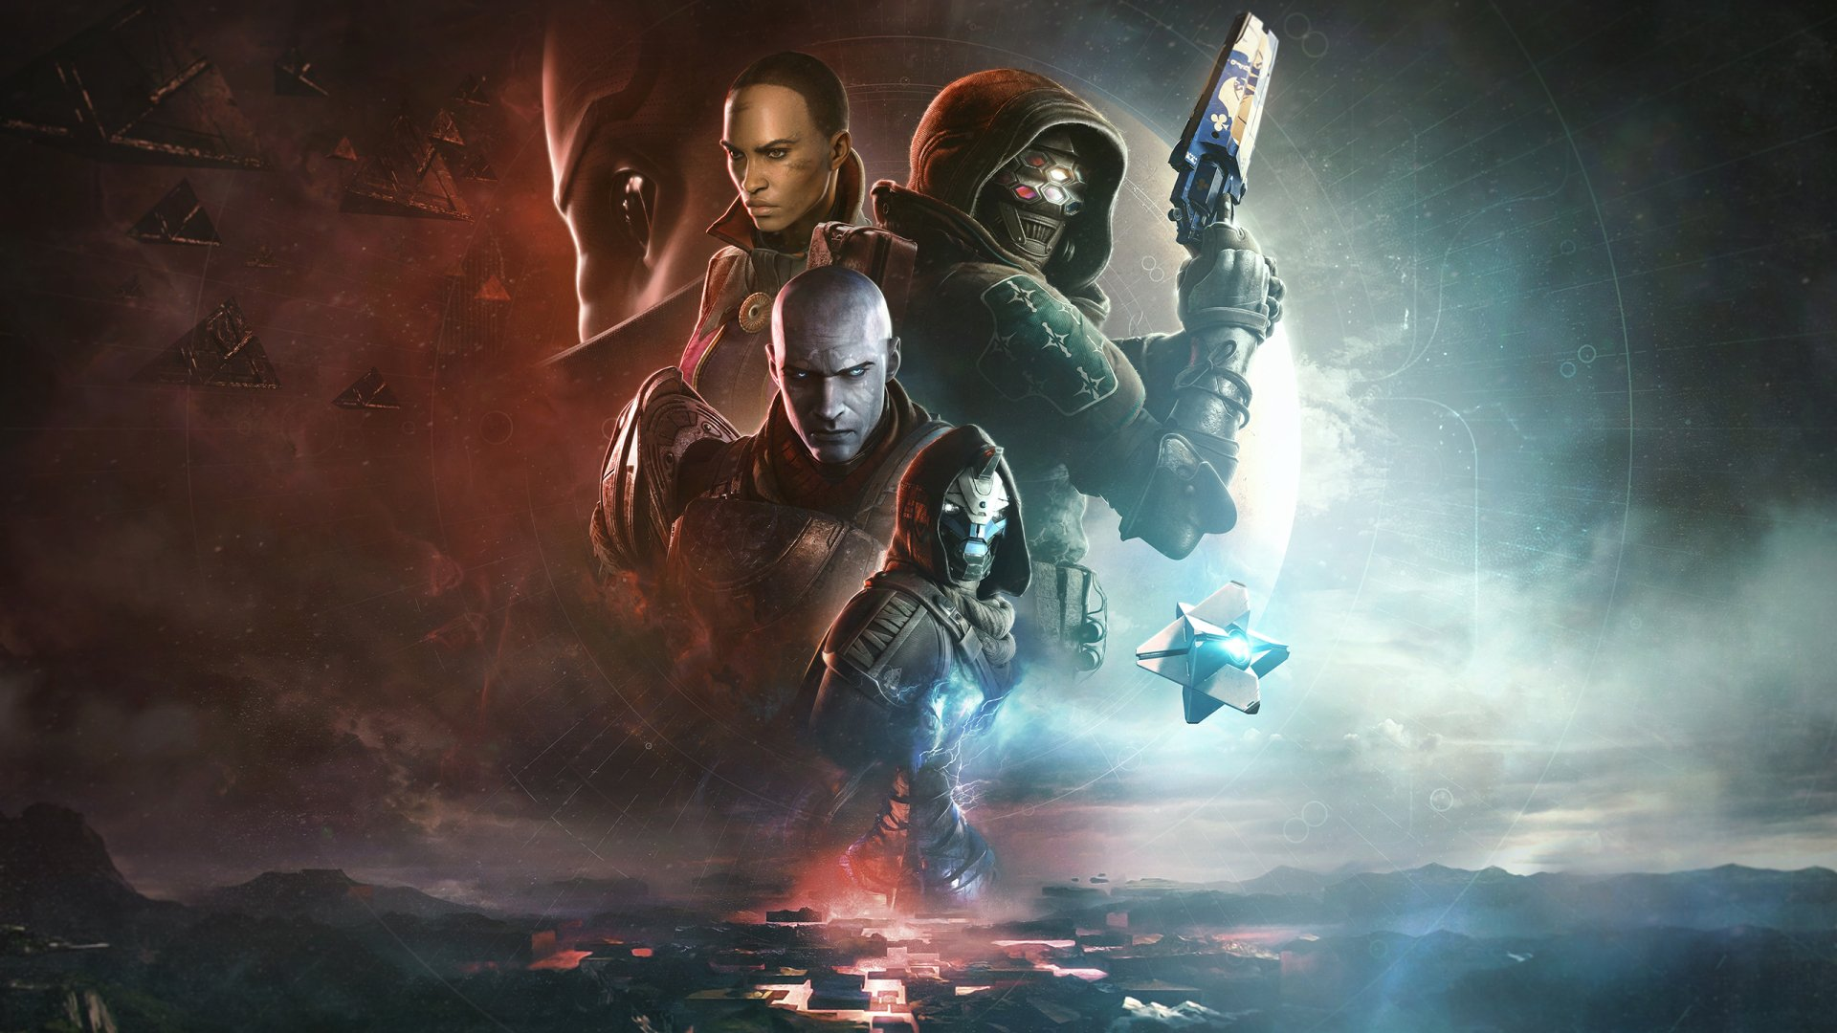
AI-Driven destiny 2 player coach (Vanguard mentor)
Author: Declan Wadsworth (drw8)
Supervisor: Dr Chuan Lu

Slide 2

Project Description
Destiny 2 is a notoriously hard to game to learn for new players, especially true the further we have gotten from its initial release, with the addition of new expansions, activities, weapons, mechanics and so on.
The aim of this project is to ease the impact of this steep learning curve through a coaching service powered by recent technologies in the space of LLMs and generative AI`s.
The coach aims to produce features in the realm of:
Character Analysis
Activity Build Suggestions
Weapon and Activity Skill suggestions
Post-Activity Analysis
Knowledge Base
Coach generated targets
Leaderboard aggregation and weighting
The project intends to create a web-application

Slide 3
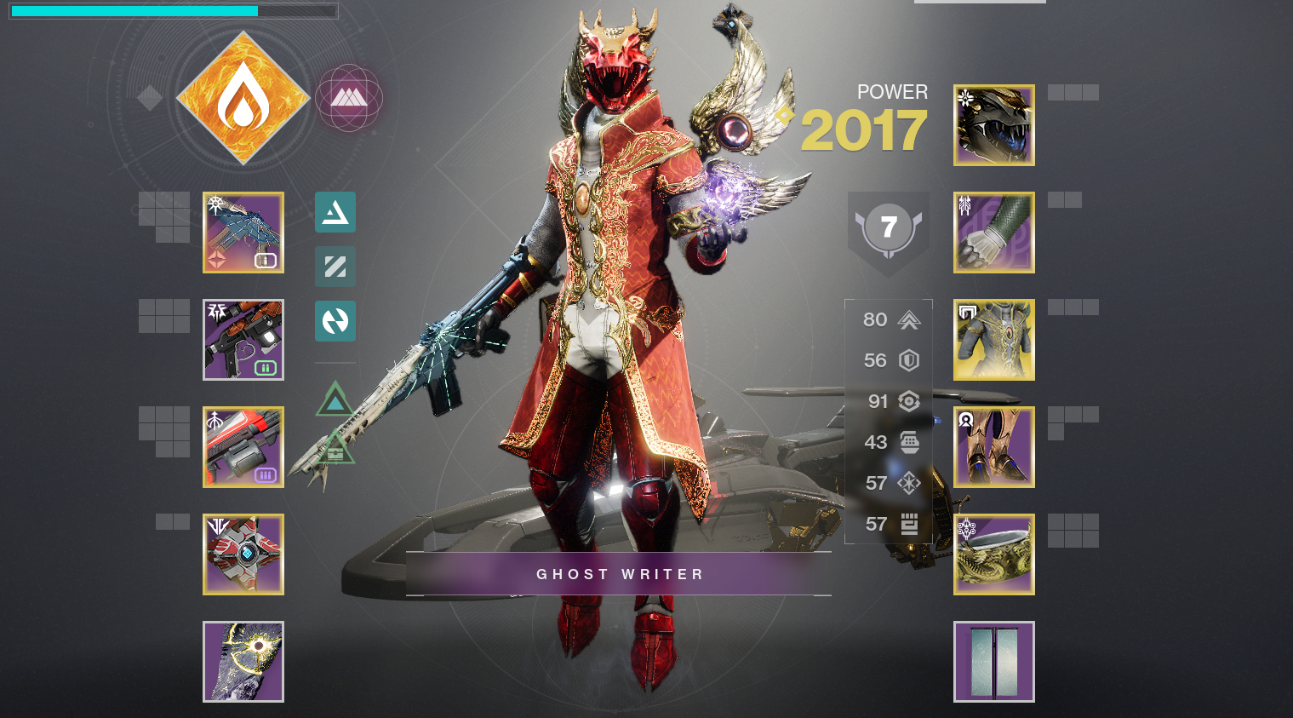
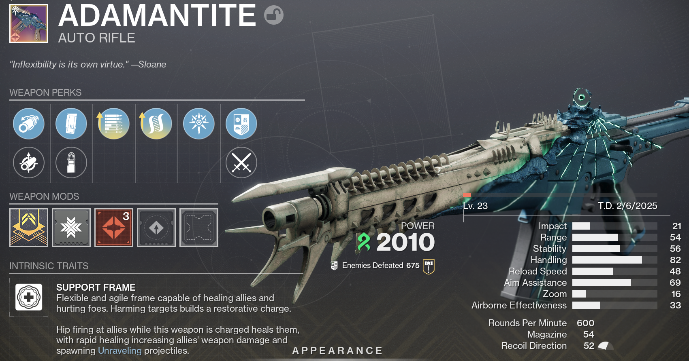
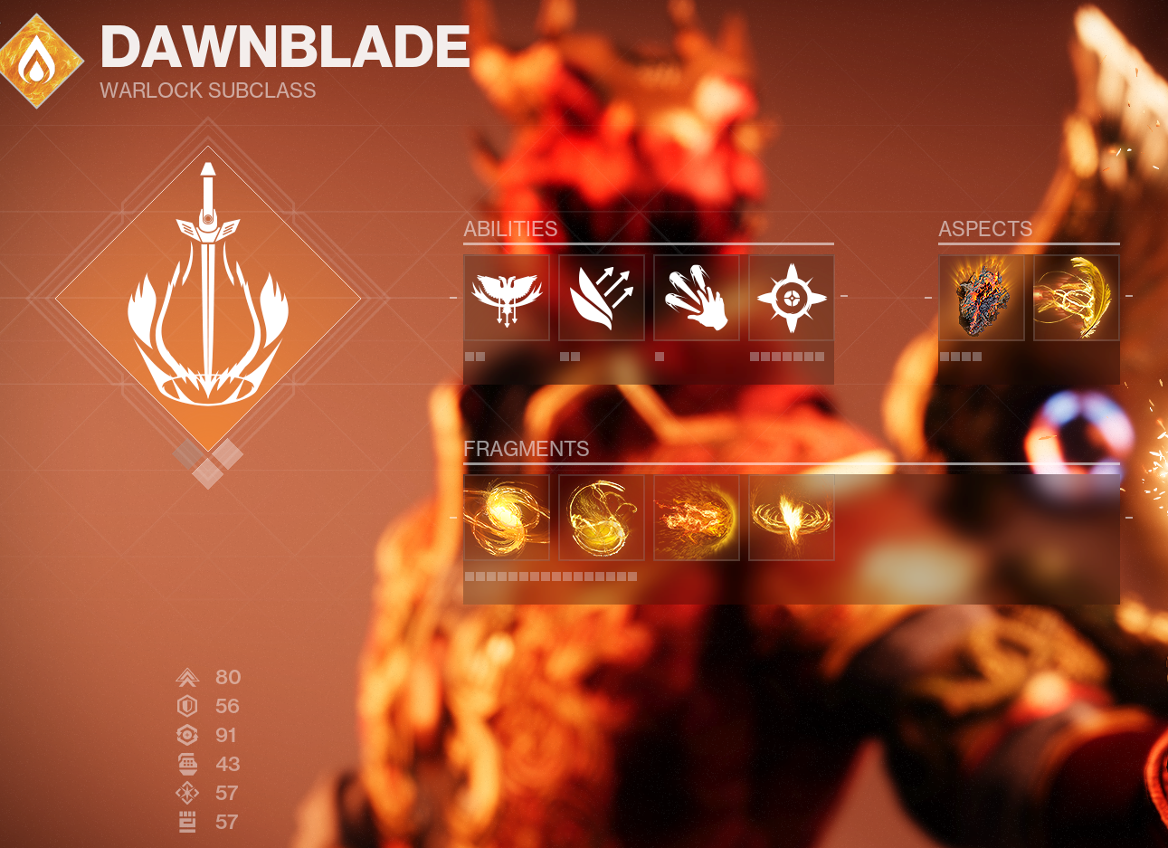
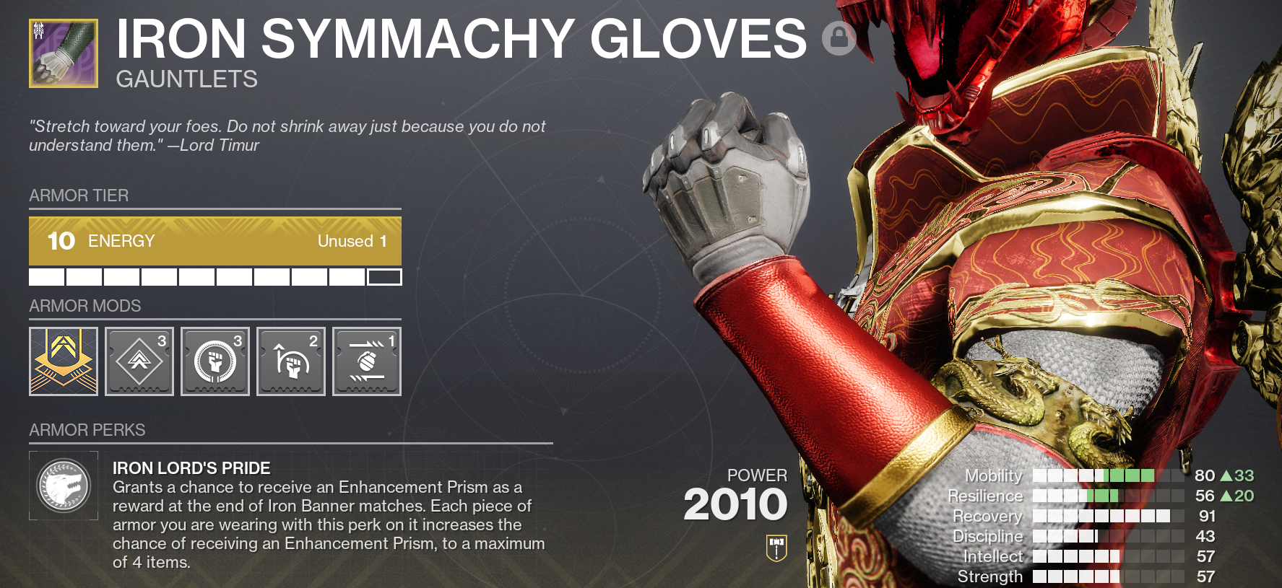

Slide 4
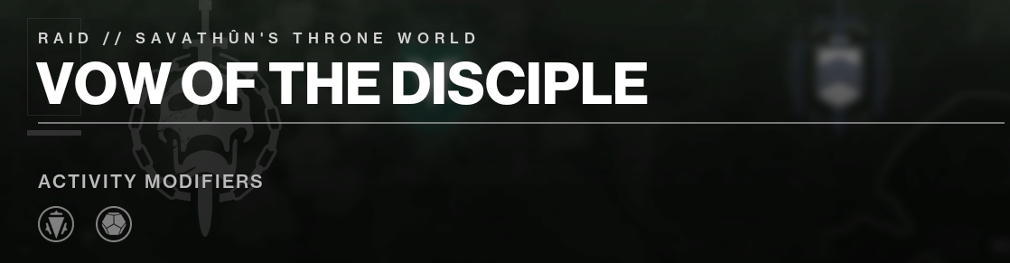
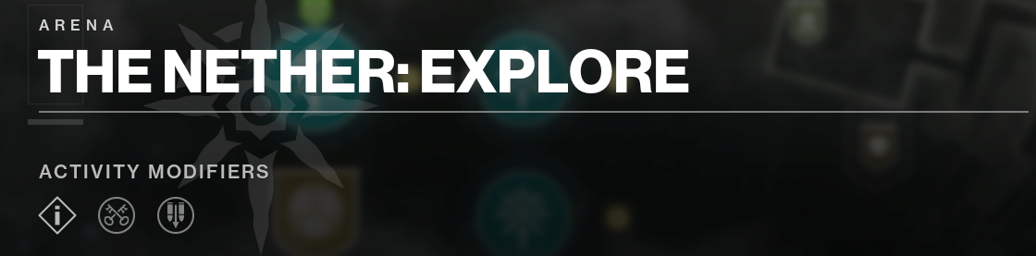
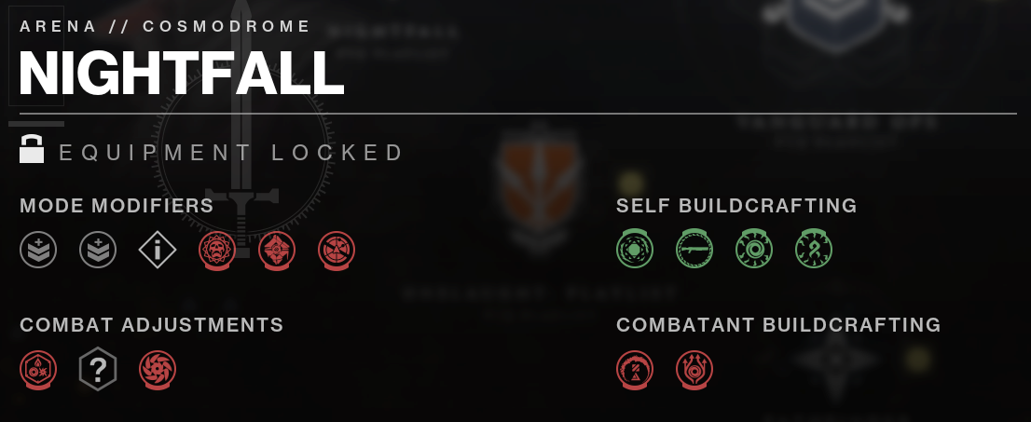

Slide 5
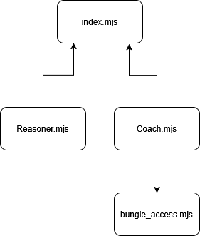
Technical Work and Progress
The following work has been carried out so far for this project:
Decision on target platform
Decision on application architecture
Design and implementation of server structure
Basic UI with login and logged-in functionality
Authentication of user with bungie
Player membership and character retrieval
Player equipped and unequipped items retrieval and parsing
Early version of activity build suggestions feature
Client initialisation from response received by server from authentication request
NOTE: As of Tuesday 11th March, the Bungie API OAuth2 redirect is disabled due to issues on their side. Developers are currently working on the issue. Normally after logging in, the user would be redirected back to my page, but this is not occurring due to aforementioned issue.

Slide 6
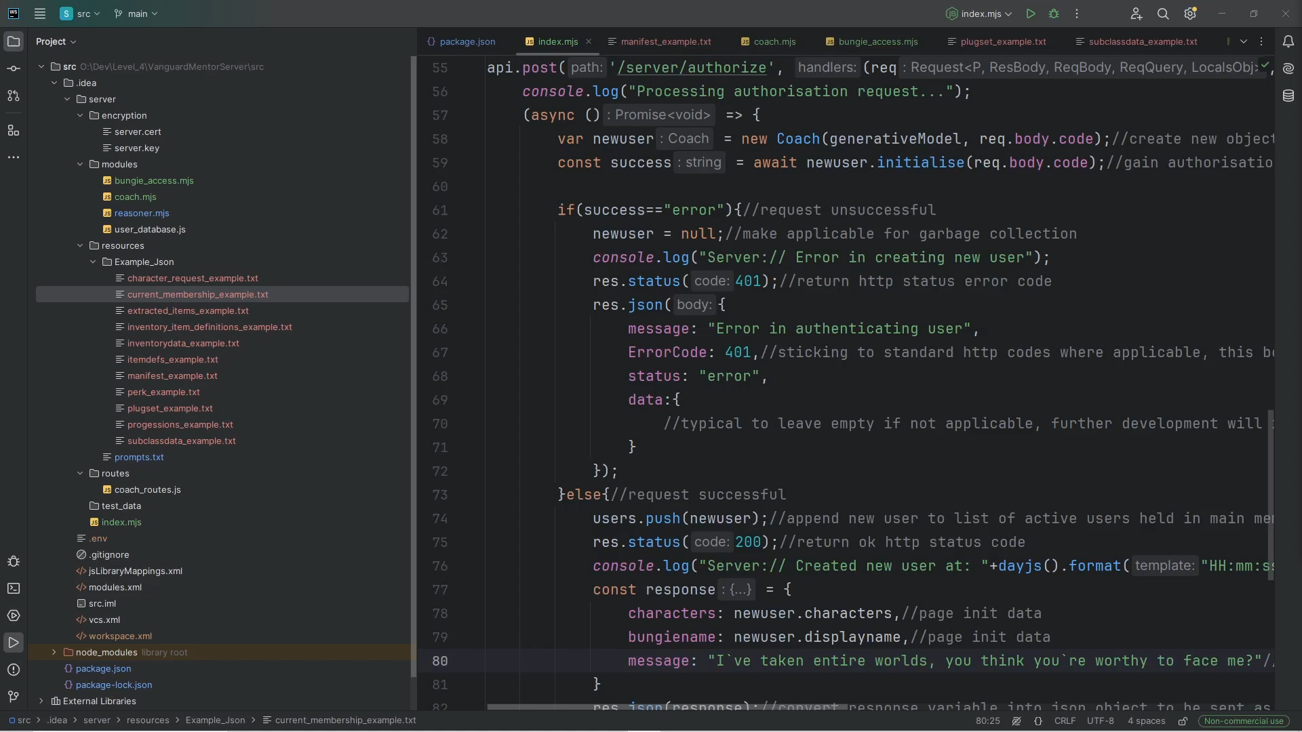
Server terminal session

Slide 7
Technologies and issues
Involved Technologies:
HTTPS Server (Secure communication between server and client)
Express (For creating REST based server architecture)
JSON
Node.js Server (ES6 Modules)
Client->Server Architecture
HTML, CSS and JS for Client
HTTP Requests
Generative-AI (Google Gemini flash-2.0)
Ngrok Secure HTTPS Tunnel
PostGres (For user database)
Issues encountered and to address:
Issues with timing of responses from requests, as well as correct use of asynchronous syntax where applicable on the server.
Communication between server and client non-functional unless third-party tool is in place (NGrok)
Dealing with concurrent users in a timely and efficient manner
Ensuring security-wise execution and communication at all times
Dealing with issues with third-party libraries and APIs (such as the aforementioned bungie.net issue)
Ensuring relatively accurate outputs from chatbot
Deciding what data to cache (permanently or temporarily)

